Slide 1

Object Orientated Software Engineering
Internships
By Derek Somerville

Slide 2
Placements What
A placement or an internship – Same
BSc Computer Science
Non-assessed placement
BSc Software Engineering or MSci Software Engineering
Ten weeks or more assessed placement
MSci Software Engineering with work placement
Ten month or more assessed placement

Slide 3
Assessed Placement
Full time 35 hours or more
On or above living wage
Working as a software engineer, some coding
Working in a team with a manager/mentor

Slide 4
Why
Good work experience
Looks good for your CV
Good experience to answer interview questions
Gain knowledge of working in industry
Do you want to be a software engineer
A number of companies takes most graduates from interns

Slide 5
Finding
You own finding your placement
Computer Science Careers Moodle
https://moodle.gla.ac.uk/course/view.php?id=3323
Internship Opportunities forum
Recruitment Process - https://moodle.gla.ac.uk/mod/page/view.php?id=2706868
CV Skills

Slide 6
Finding
ePlacement can also offer placements
Graduate Cracker also offer placements
Careers Service - University of Glasgow (targetconnect.net)
Internship Hub - University of Glasgow - MyGlasgow - Careers Service - Finding jobs and work experience - Internships

Slide 7
Preparation
Companies give talks about CV writing
Careers CV clinics
Companies give talks about interviews and assessment centers

Slide 8
Preparation
Good team player
Good coder and enjoys it
Attend hackathons and conferences
Repository of work e.g. github
Make the most of the team project
Some companies start mid August, rounds of hire

Slide 9
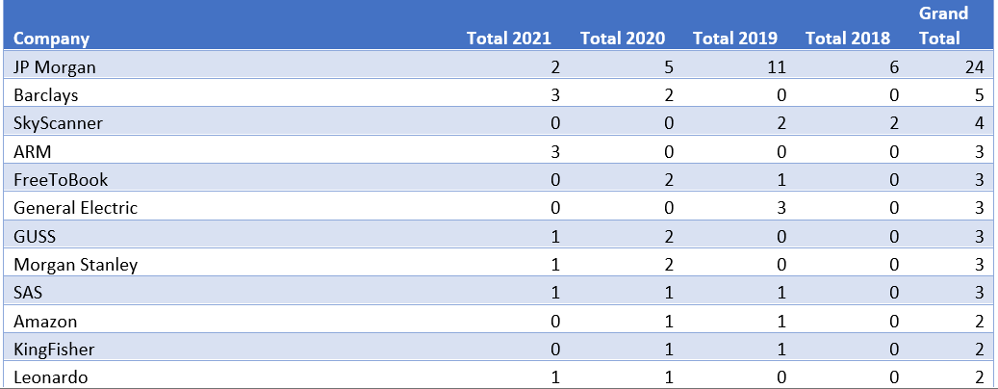
Preparation

Slide 10
Summer Assessed
Between third and fourth year
One visit for 30 minutes with you and 15-30 minutes with your manager
Poster and Presentation in October

Slide 11
Full Year
Between third and fifth year – Your fourth year
Ten months
Failure to complete fifth year is a designated

Slide 12
Full Year – Assessments
Visit 30 minutes with you and 30 minutes with manager in first two months
One day University workshop
40 weekly diaries
30 minutes lean coffees – Online meetings
Project Proposal
Literature Review
Second visit

Slide 13

Internship – Any Questions

